Slide 1
Paper Prototype: Hikari no To
Computer Games Laboratory 2017/2018
Team Pick One:
Muhammad Inshal Uddin
Paul Preißner
Jonas Mayer
Artem Bishev
Technical University of Munich
15.11.2017

Slide 2
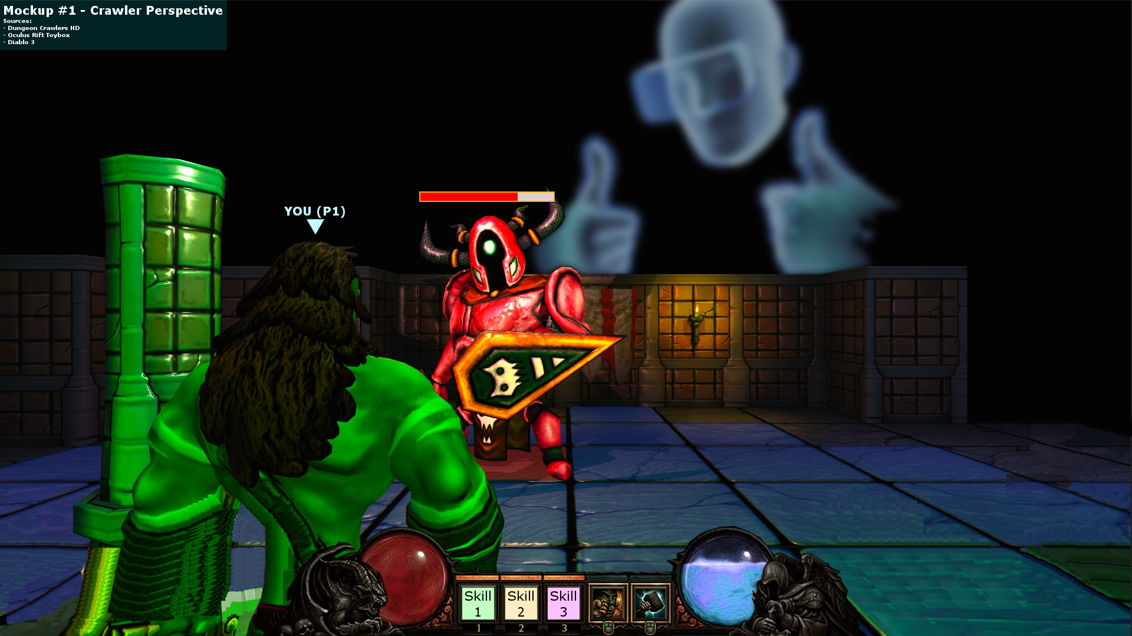
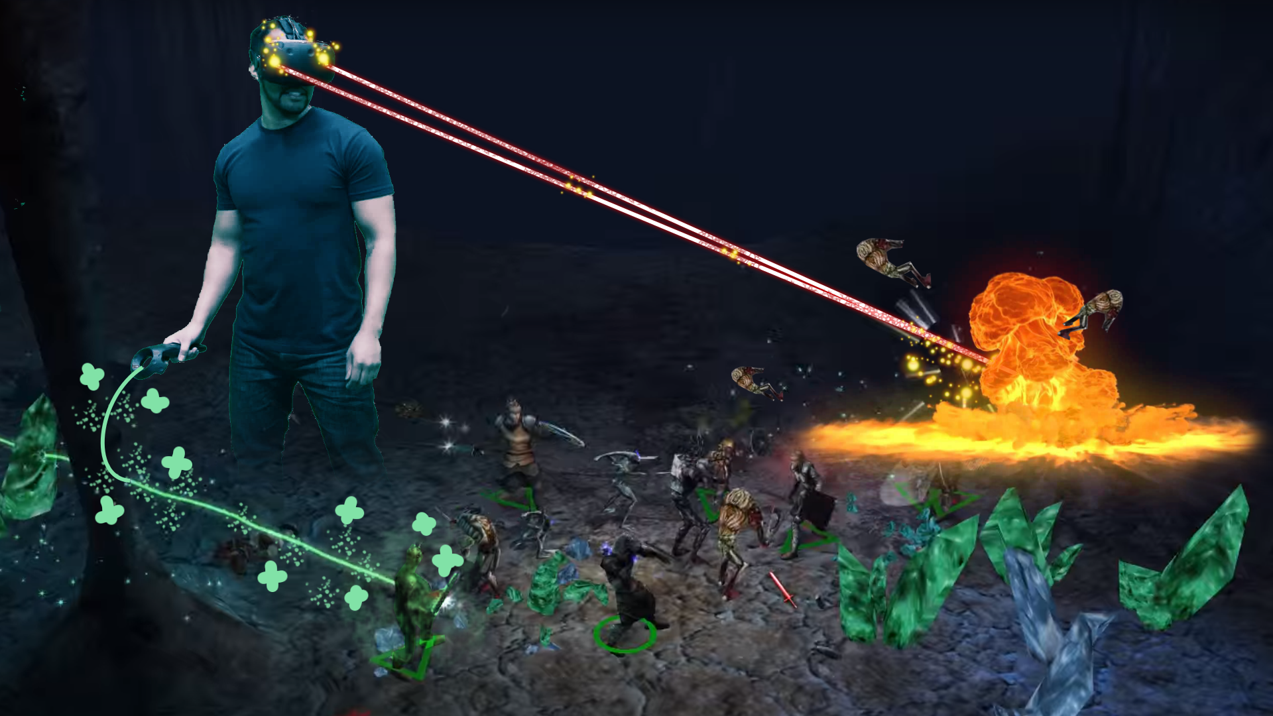
A Brief Review Co-Op Dungeon Crawler with a Dungeon Master
Crawlers
Explore
Plunder
Fight
Dungeon Master
VR
Guide
Support
Mechanics
Find each other
Work together
Reach end-goal

Slide 3
Paper Prototype

Slide 4
Prototyping – Basic Setup
Map divided into a grid of 4x4 modules
Each module is subdivided by a 5x5 tile-grid
Players have their own copy of the map
All maps are in the same orientation
T-Shaped divider separates players

Slide 5
Prototyping – Entities I
Entities represented by coloured post-its
Players
Loot
Enemies
Boss

Slide 6
Prototyping – Entities II
Enemies
5 HP
2 tiles per turn
1 damage
Boss
20 HP
3 tiles per turn
2 damage

Slide 7
Prototyping – Entities III
Players
10 HP
3 tiles per turn
Damage based on D6
Loot
Roll d4
Master gets corresponding ability

Slide 8
Prototyping – Master I
Once action per turn
Gesture to one player
Use an ability
Four abilities
Fireball 🔥
Heal ➕
Buff ⬆️
Debuff ⬇️

Slide 9
Prototyping – Master II
Restrictions to represent multitasking constraints
Can see entire map including
Boss
Loot
Not enemies

Slide 10
Prototyping – Crawlers
Only current module is flipped up
All others flipper over
Moving to edge of a module reveals next module
Two actions per turn
Move
Attack
Objectives Revisited
Explore map
Avoid enemies
Defeat boss

Slide 11
Prototyping – Results I
The Happenings
Master helped crawlers avoid enemies
Crawlers listened for the most part
Crawlers were brought together
Boss defeated

Slide 12
Prototyping – Results II
The Fun
Surprises around corners
Teamwork leading to victory
Crawlers acting out of line occassionally
The Boredom
Master skipping turns (Turn-based pace too slow)
Combat too easy (Balancing in later stages)

Slide 13
To the Prototype!

Slide 14
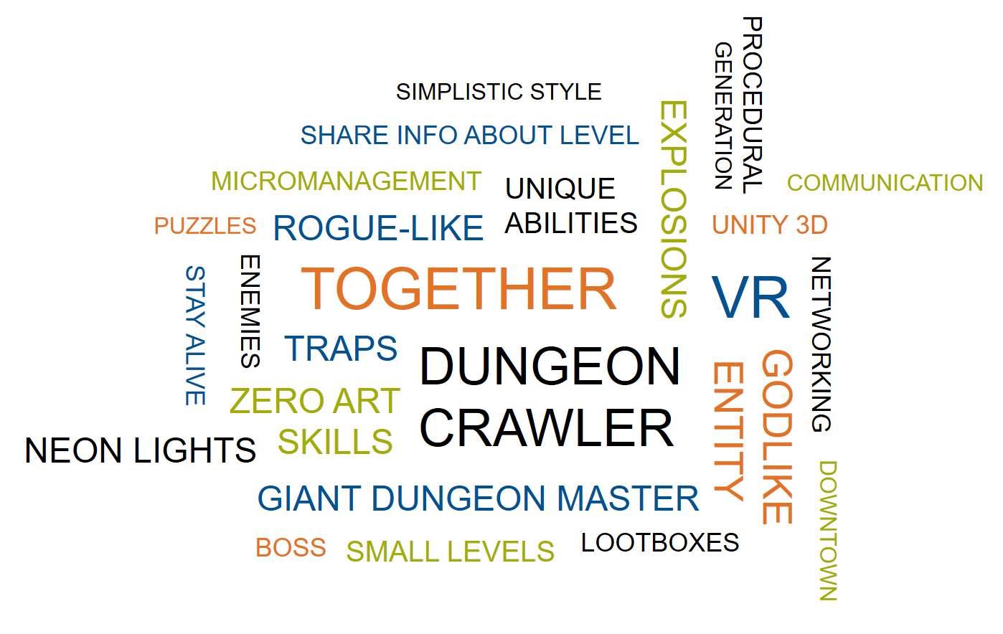
Q&A

